Slide 1
Analysis on Traffic Violation Data
Team Outliers
Kim Minsu, Kim Won Hyun, Liu Siyuan
Zhang Linghan, Tan Chin Won

Slide 2
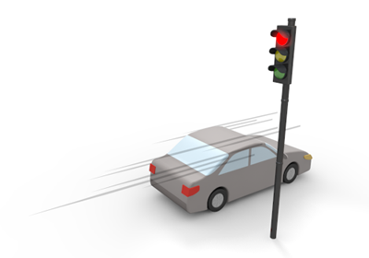
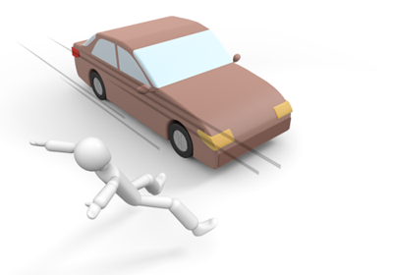
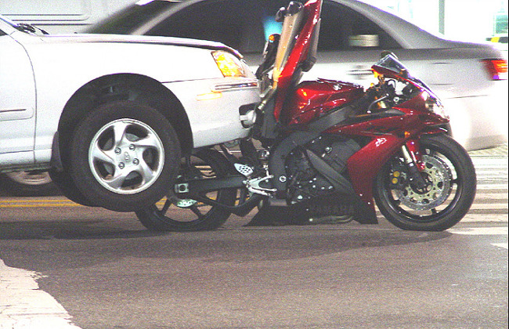
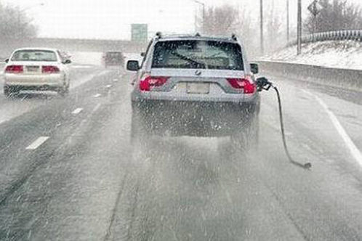
Background & Motivation

Slide 3
Questions
Q1 : How are the traffic violations distributed?
Q2 : What are the differences in characteristics on traffic violations between genders?
Q3 : What is the trend of the number of traffic violations in time series?

Slide 4
Our Dataset
Traffic violation data in the Montgomery County, Maryland
About 680000 entries from 2012 to 2015
The dataset includes information about: - date, longitude, latitude, belts, fatality, alcohol, vehicle’s model, race, gender and etc.

Slide 5
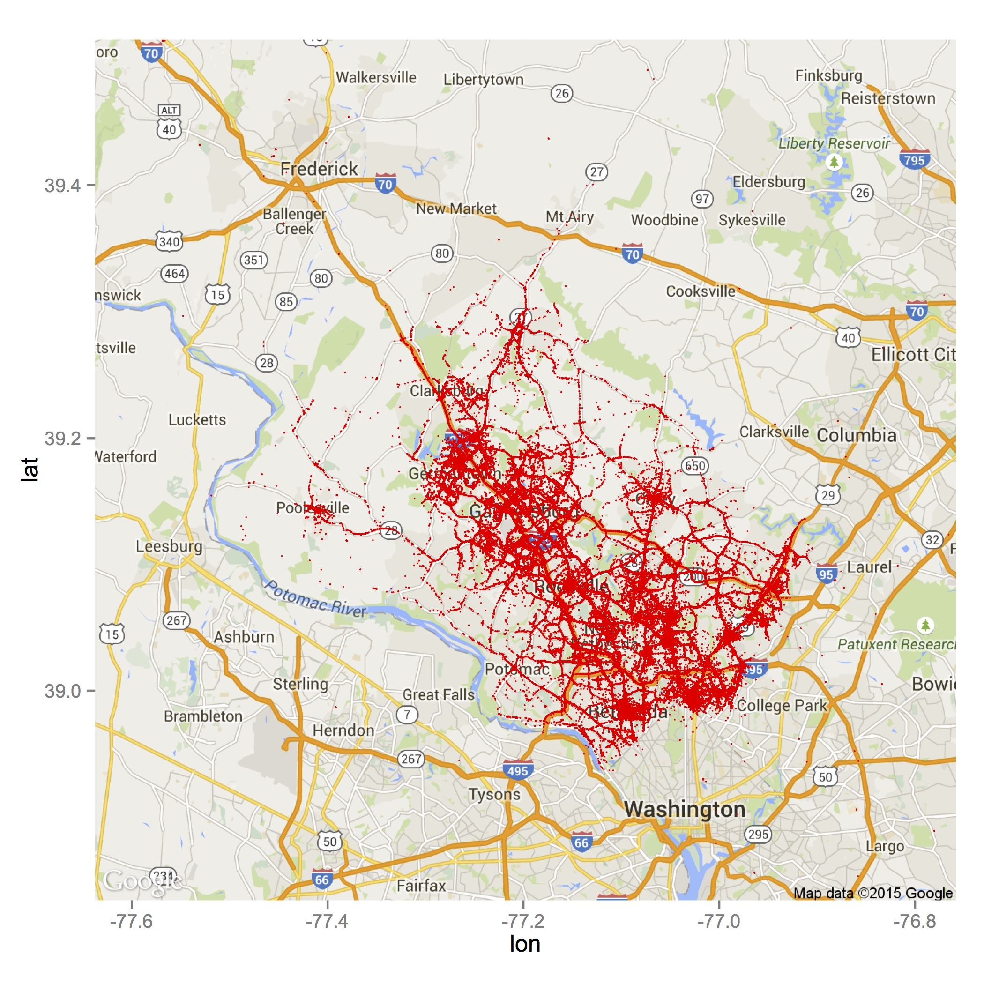
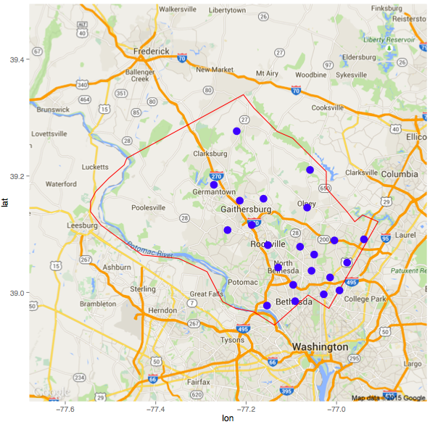
Analysis for Question 1
Methods
K-means
Results
Map Plots of violation locations
Interpretation

Slide 6
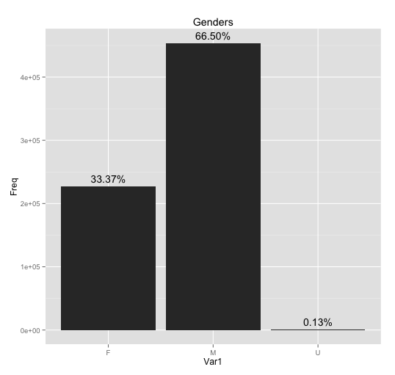
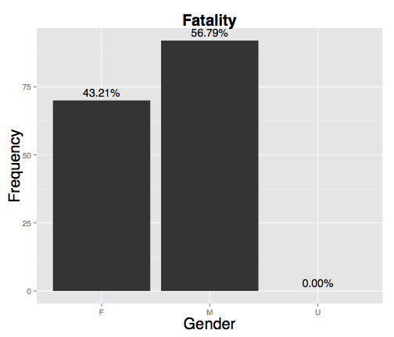
Analysis for Question 2
Violation in Total
Violation with Fatality
Methods
Results
Bar plots of violation count by gender
Interpretation
Gender
Gender

Slide 7
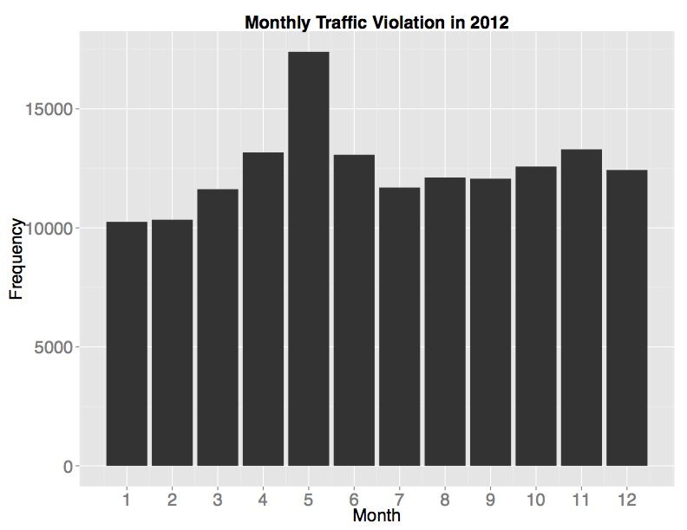
Analysis for Question 3
Methods
Linear regression
Results
Bar plots of monthly and yearly violation count
Interpretation

Slide 8
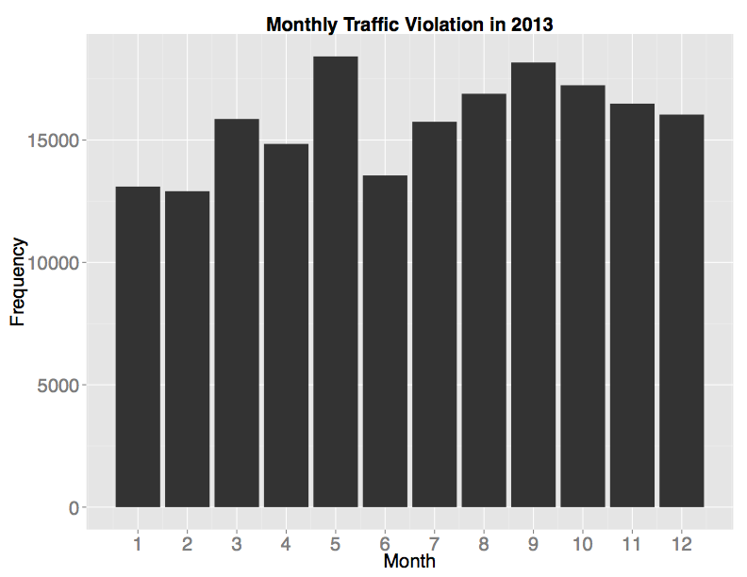
Analysis for Question 3
Methods
Linear regression
Results
Bar plots of monthly and yearly violation count
Interpretation

Slide 9
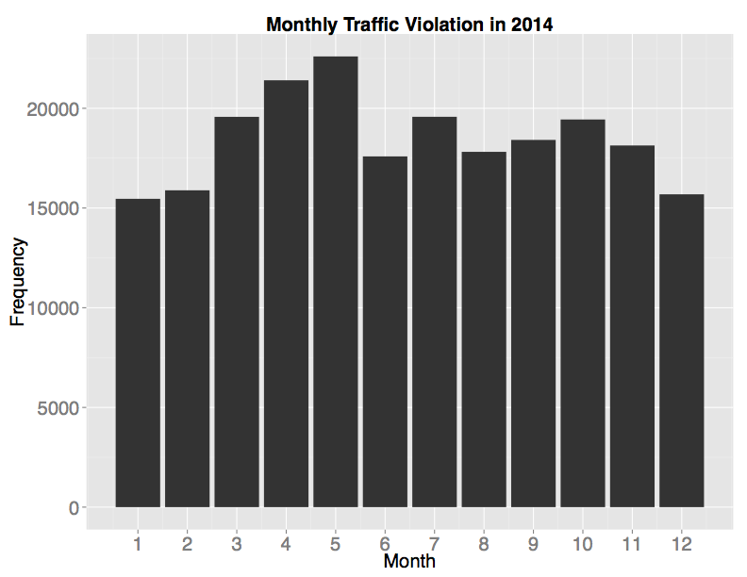
Analysis for Question 3
Methods
Linear regression
Results
Bar plots of monthly and yearly violation count
Interpretation

Slide 10
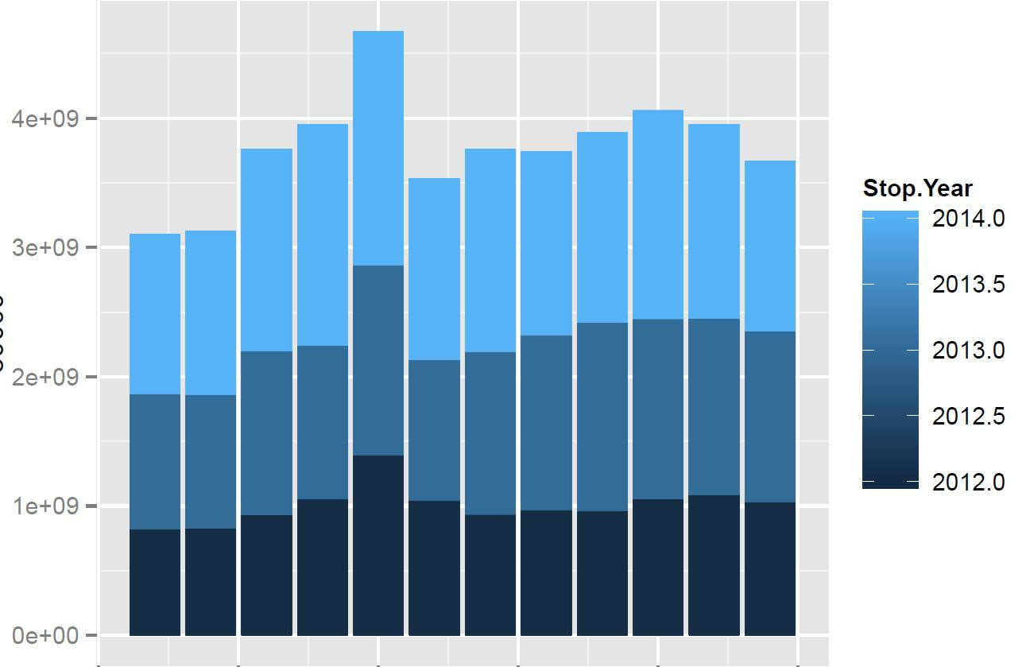
Analysis for Question 3
Stacked Monthly Traffic Violation
Methods
Linear regression
Results
Bar plots of monthly and yearly violation count
Interpretation
Frequency

Slide 11
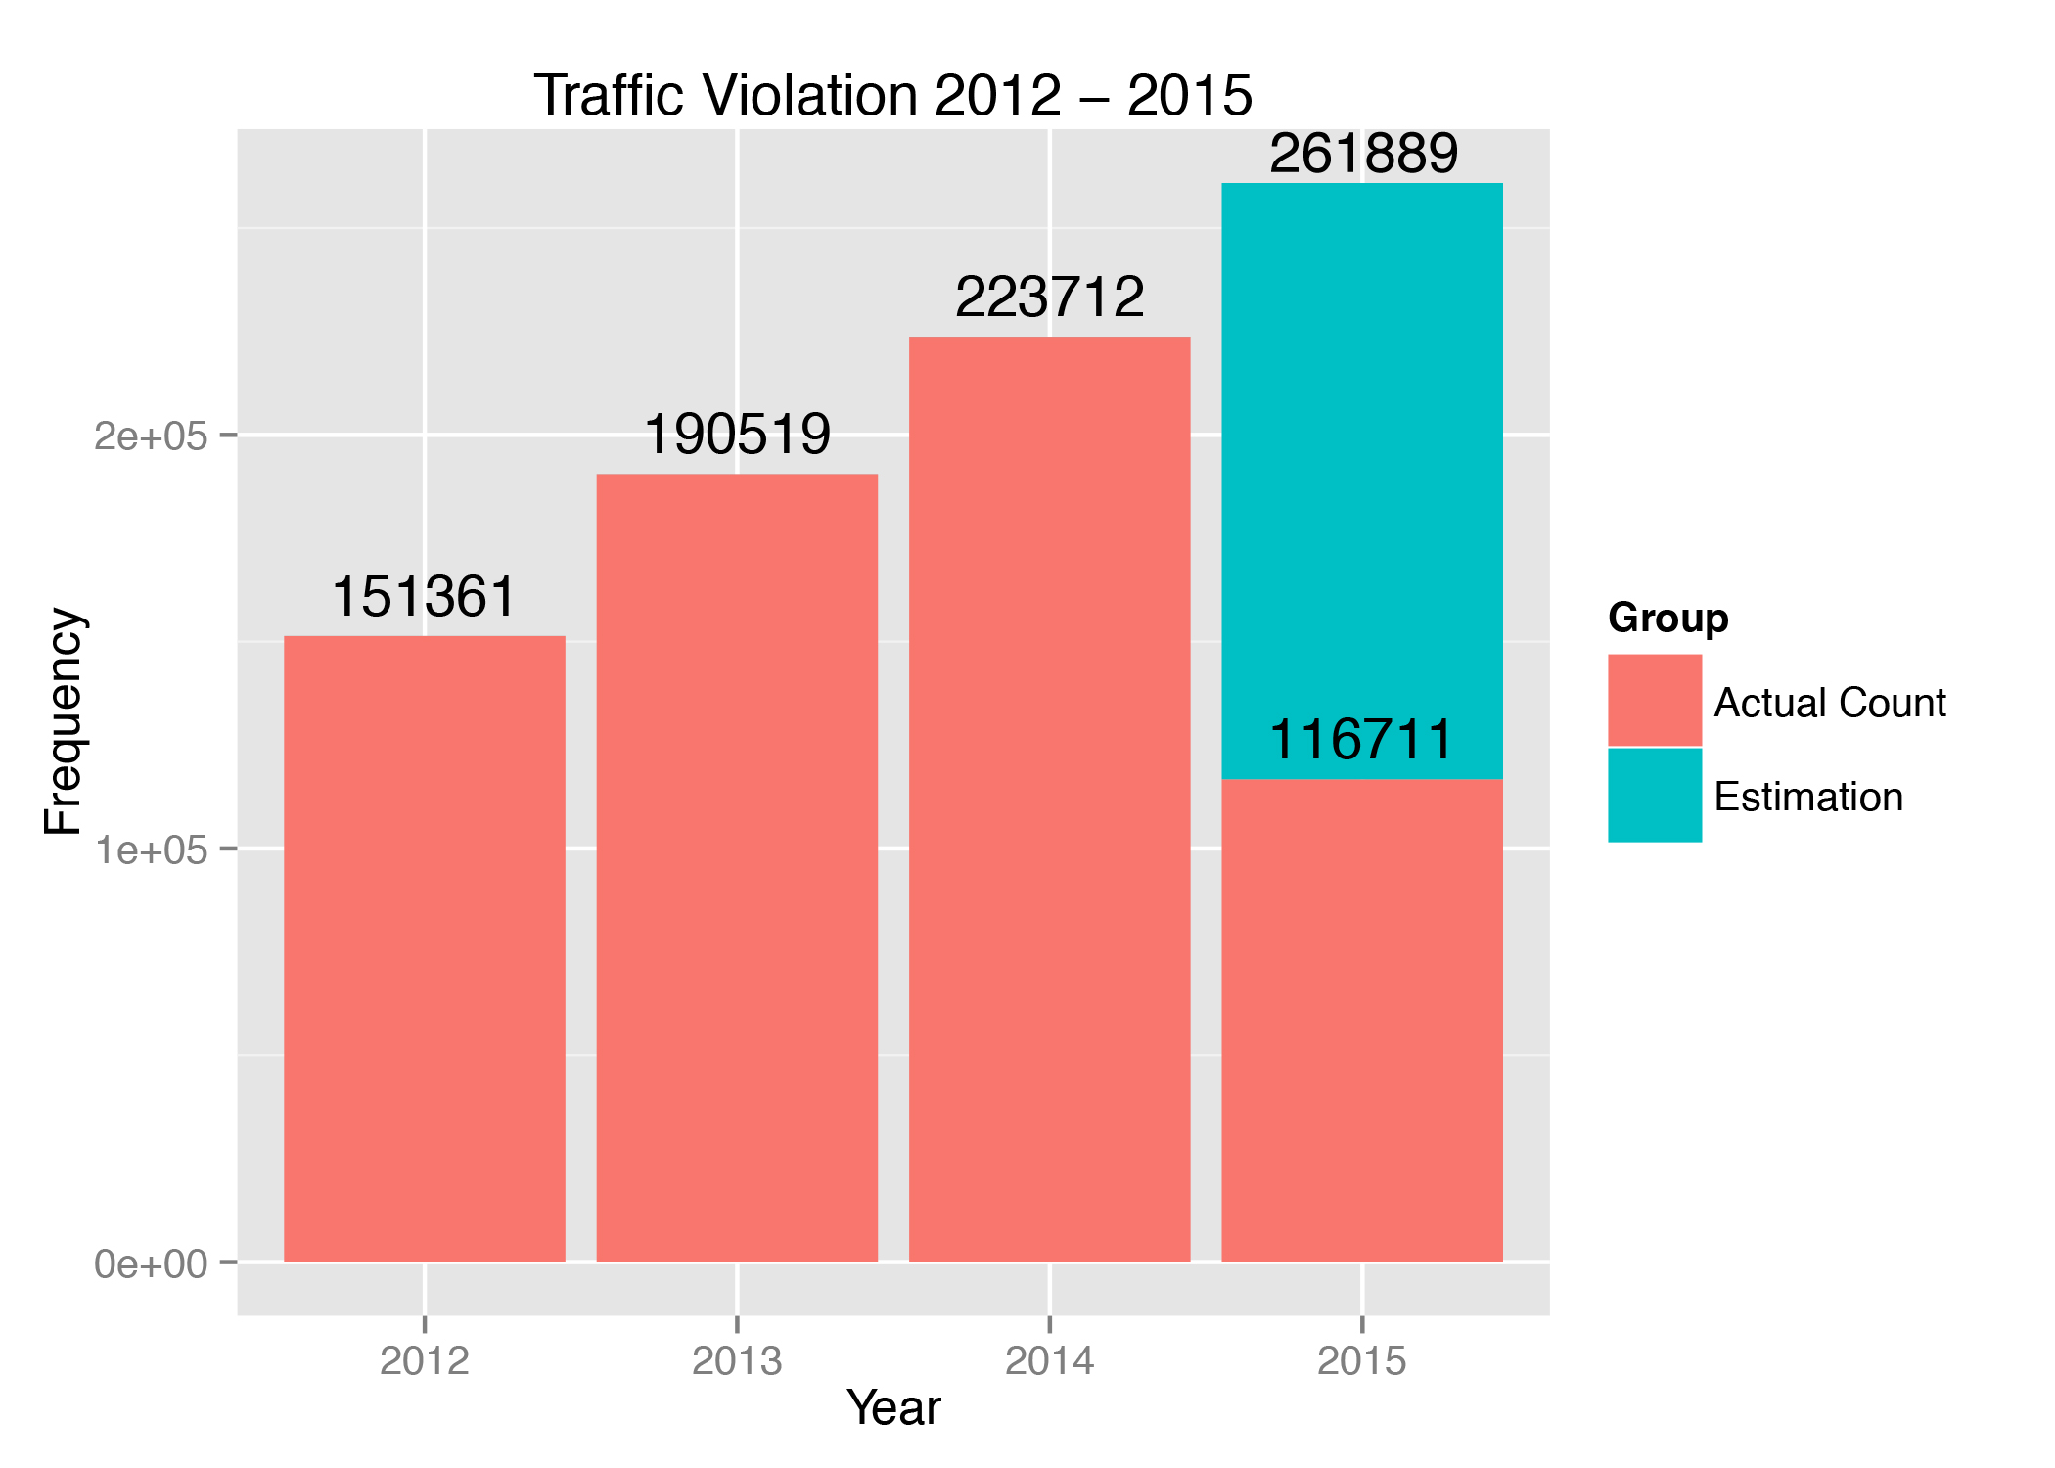
Analysis for Question 3
Methods
Linear regression
Results
Bar plots of monthly and yearly violation count
Interpretation

Slide 12
Conclusion & Future Direction

